Slide 1

STELLA OBASANJO HOSPITAL Edo state ministry of Health
SOH RECALIBRATION COST
TANIT MEDICAL ENGINEERING
TANIT MEDICAL ENGINEERING January 2023

Slide 2
Summary
The entire project (OPD, IPD, Administrative block & Mortuary) of the SOH for ease of execution has been suggestively phased into 2.
Phase 1
Complete construction and equipping of the OPD block
All portions of IPD highlighted in green, namely:
Diagnostics
Dialysis
IVF
ER
Medical gases
UPS
36 Surgical wards
Phase 2
Completion of the IPD block
Mortuary
And all other structure
TANIT MEDICAL ENGINEERING
TANIT MEDICAL ENGINEERING January 2023

Slide 3
Cost Analysis for preferred option
FULL PROJECT
(WITH ADMINISTRATIVE BLOCK)
18,650,279,844.56
Phase
OPTIONS | SCENARIO TOTAL SUM (₦) | DIFFERENCE (₦) | SCENARIO COVERAGE AREAS
OPTION 3 | 9,621,654,041.96 | 9,028,625,802.60 | OPD, All area marked in green in the IPD as reflected in the drawing (DIAGNOSTIC,DIALYSIS,IVF, ER, MEDICAL GASES,36 SURGICAL WARDS AND UPS)
TANIT MEDICAL ENGINEERING
TANIT MEDICAL ENGINEERING January 2023

Slide 4
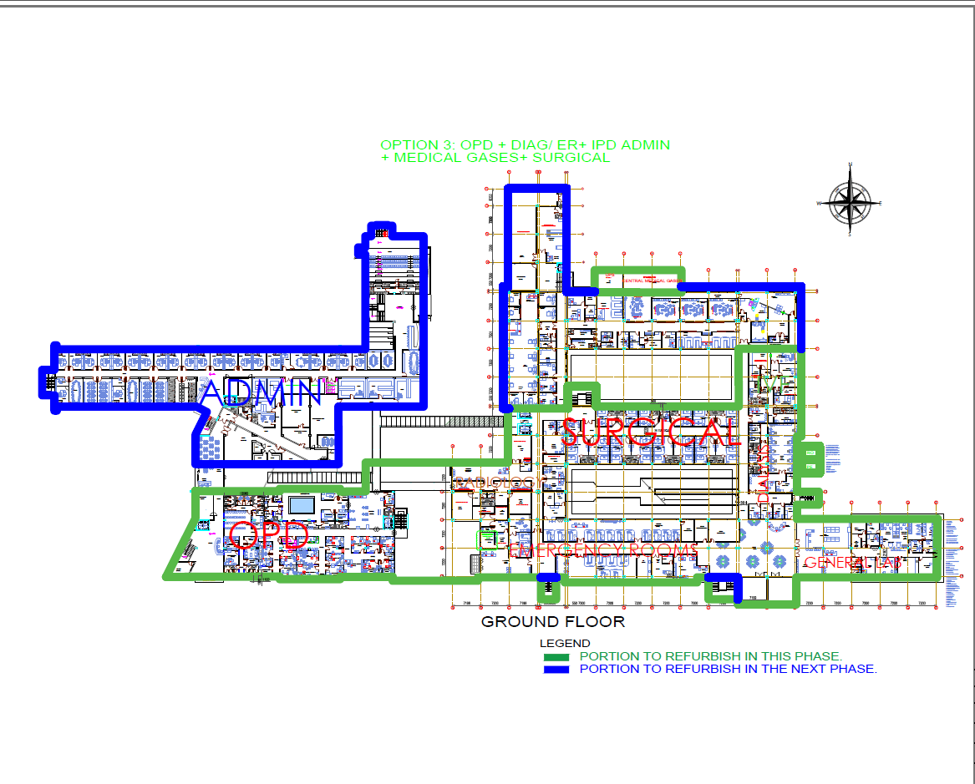
The design (Ground floor plan)
TANIT MEDICAL ENGINEERING
TANIT MEDICAL ENGINEERING January 2023

Slide 5
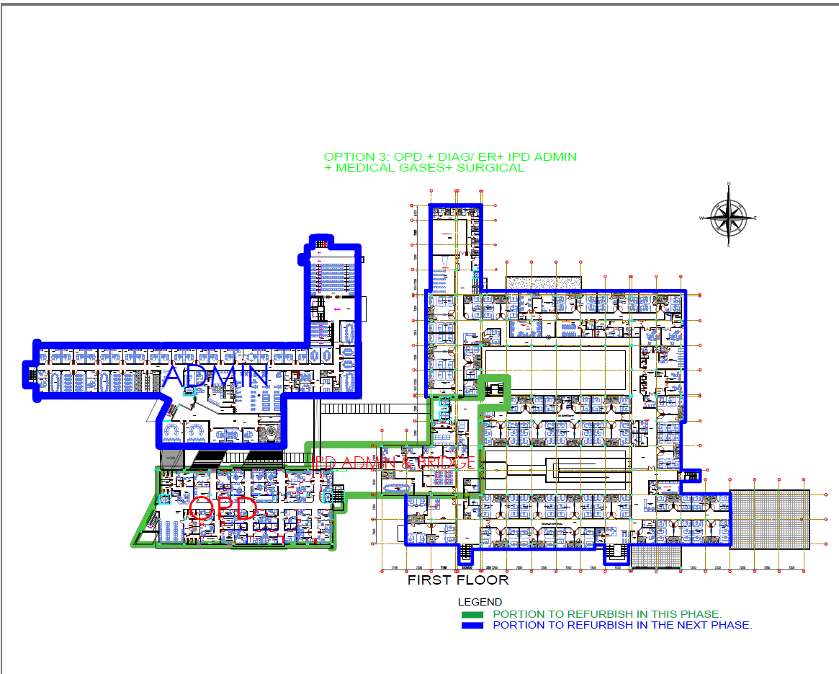
The design (First floor plan)
TANIT MEDICAL ENGINEERING
TANIT MEDICAL ENGINEERING January 2023

Slide 6
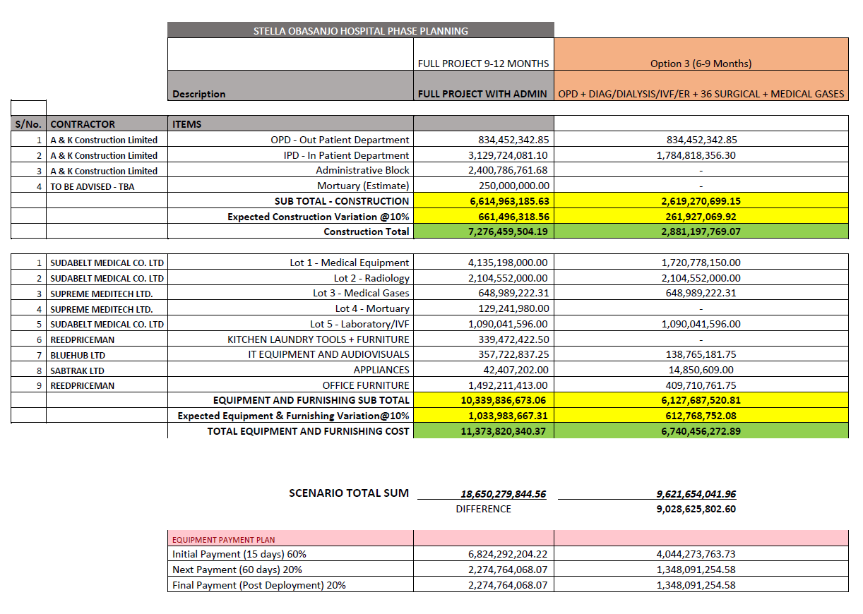
Cost breakdown
FULL PROJECT
(WITH ADMINISTRATIVE BLOCK)
₦19,026,618,100.41
Phase
TANIT MEDICAL ENGINEERING
TANIT MEDICAL ENGINEERING January 2023

Slide 7

End of Presentation
A big thank you from all of us
at
Tanit Medical Engineering
₦19,026,618,100.41
TANIT MEDICAL ENGINEERING
TANIT MEDICAL ENGINEERING January 2023

